Slide 1
Writing a monologue
In prose, an interior monologue is where one character reveals what's going on in his mind and gives his thoughts using associations, imagery, impressions, wordplay and other literary devices. Since a monologue involves a single character speaking for an extended period of time, you need to make certain that your character’s voice is distinct to his or her personality and that it remains consistent.
Through monologues we find out about the very essence of these characters: who they are; what their thought process is/are and what they plan to do to change their current circumstances/deal with conflict/issues etc.
Flowing language is one part of making a monologue effective. However, if there is no emotional stimulus the monologue ends up being flat. Emotions make the character. You need to fully explore your character’s emotional state to create a character who will genuinely engage your reader.

Slide 2
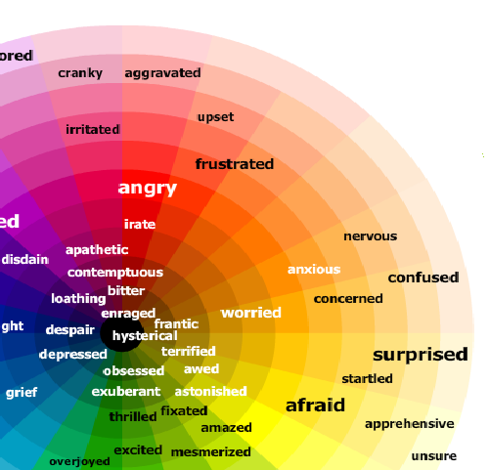

Slide 3
Planning an effective and powerful monologue:
Identify the character you think would suit a monologue. As this is a device for introspection, a superficial character who doesn't reflect on their actions or beliefs isn't suitable for an interior monologue. You must know your character’s mind well as an interior monologue reveals what the character thinks and feels about a particular situation, person or issue and what motivates his actions.
Decide why you want to portray the character's thoughts in an interior monologue. This will help focus the monologue topic. You can expand on a major theme of your story; highlight an important character trait or discuss other characters through the eyes of your monologue subject.
Find the place(s) most suitable for an interior monologue (somewhere your character can fully reflect/introspect in the situation they find themselves in e.g. graveyard, beach, park etc.)

Slide 4
Structure of a monologue
Exposition
Is there an idea you would like to convey? Is the character’s voice speaking to you? Where is the character? Allow the environment to inform your work. If they are on a train, why are they there? Who is around them? etc. Why is your character speaking? Inevitably, this question will provide you with “the hook.” Occurring within the first few lines, this will draw the audience’s attention to the character. The hook automatically creates tension in the story. It sets the major dramatic question into motion. What is the character looking to discover or explain?
Rising Action
Your character will elaborate/speculate/ponder/reflect on issues around the key theme. Allow the character to have a variety of feelings or thoughts. The tension/conflict your character is dealing with should be building towards the climax.

Slide 5
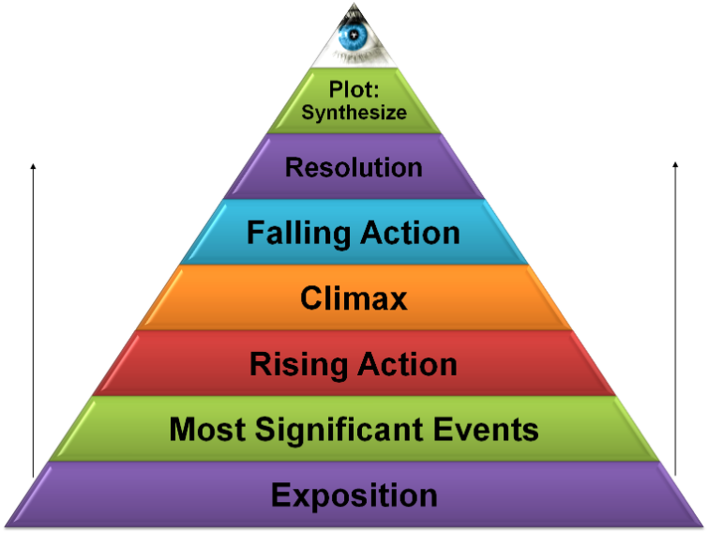

Slide 6
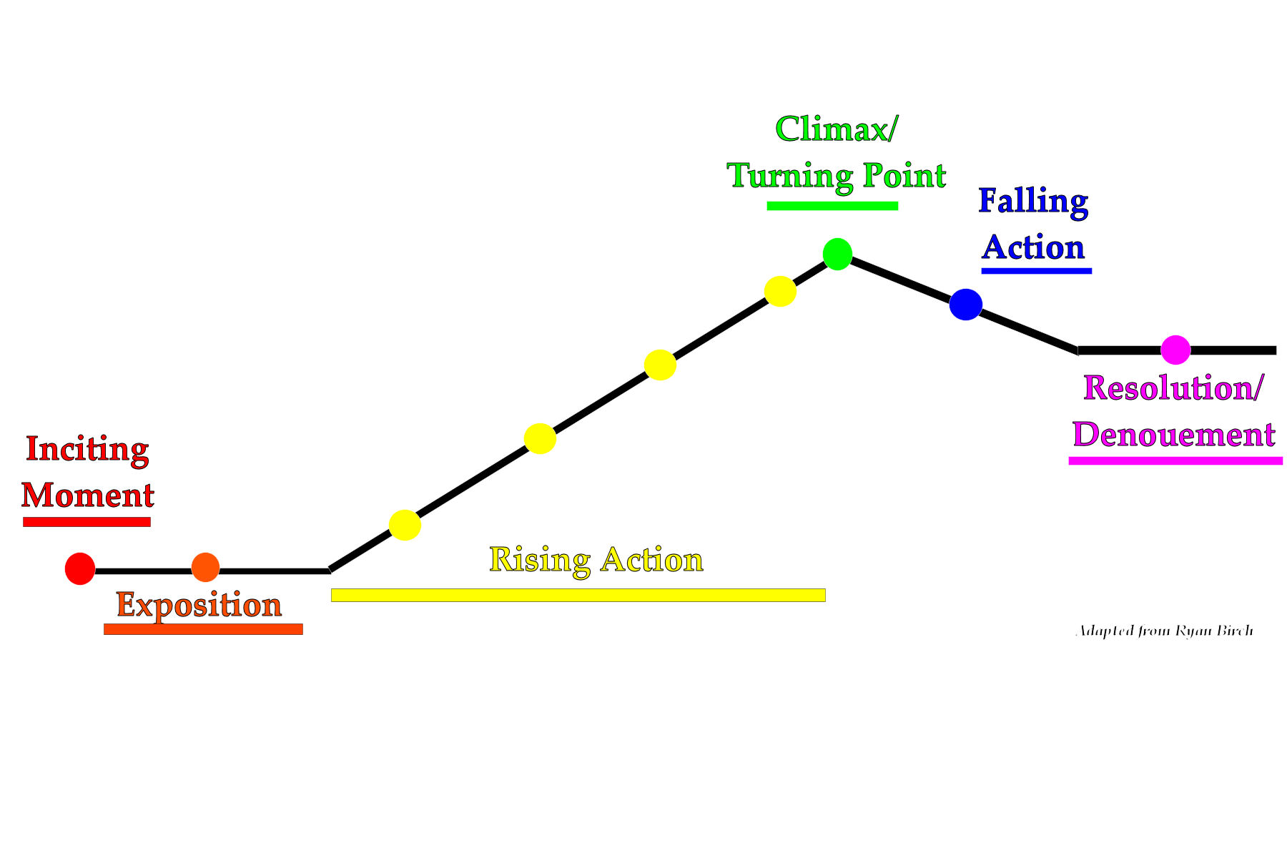
Climax
The climax is essential as it encompasses the core thought of the story. What is the character really trying to say?
Falling Action/Denouement
It is essential to have an ending to your monologue. The ending provides resolution and closure.

Slide 7
Key Tips/Advice
Description
Include detail that engages the senses. A monologue should make us empathise. If the audience isn’t feeling what the character is feeling; if they aren’t going through something with the character, the monologue has not achieved its purpose. One of the most effective ways to engage your audience is to engage their senses using the five senses (especially sights, sounds, smell, touch.)
For instance, using sensory details can communicate to a reader how a character is feeling without the writer having to label the emotion. If someone tells us that when someone approached them, their heart began to race, we know they’re excited or scared (depending on the context) without them having to spell-out for us what emotion they were feeling.

Slide 8
Balance Past and Present Action
If you write a monologue that has your character recount a story, think of how they are using it as a tactic to accomplish something with whomever or whatever they’re speaking to now. Your character might recall a story to prove a point to their listener.
Here are a few examples of how a character can use past events to deal with their own internal obstacles: A character may recount a painful memory—something that is holding them back—in order to heal. To fight sadness in the moment, a character may recall a happier time. To fight weakness in the moment, a character may recall a story that illustrates their strength. Walk the tightrope between past and present action well and you'll be on your way to a strong monologue.

Slide 9
Desire/Need Your character must have a strong desire/ambition/goal. Think about the times you have become the most aggressive/upset and most likely, if you felt this strongly, it was related to something you wanted or cared about very much. Without a strong desire/need, there is no drama – or comedy for that matter.
Often the character needs to get something from the person they’re delivering the monologue to. They may need to unburden themselves by revealing a secret. Or they may need to get themselves charged up to do something difficult. They might speak a monologue to build courage, strength, or bravery for a task ahead or they may want to speak in order to change the way someone feels about them. If the character has an internal struggle, they may be speaking in order to change the way they feel about themselves. Whatever it is your character desires, we need to hear that desire clearly behind the words they’re speaking.

Slide 10
Obstacles
Some of the most interesting monologues feature internal struggles. It engages the reader as they see the character in a state of weakness and turmoil from which they are able to emerge stronger, even changed, as they overcome the internal obstacles/doubts/fears that stand in their way.

Slide 11
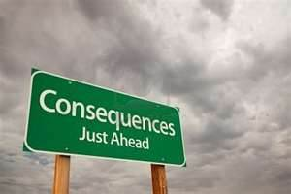
Consequences
There must be something important or significant at stake for your character. If the character doesn’t get what they want, what will be the consequence? Perhaps they’ll lose social standing, lose a friend, lose their self respect. Maybe they’ll lose their faith, or lose their one chance to prove their love to someone. This will give your monologue dramatic tension.
There has to be something at stake for the character, so that if they fail to achieve their goal in the monologue, there will be significant negative consequences for them. This clearly has emotional stakes as well—they’ll feel remorse, loneliness, etc. When working on developing your monologue, ask yourself: what is at stake for this character?

Slide 12
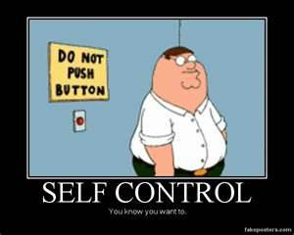
Restraint
Exercise restraint to build dramatic/comedic tension. Most of us try to avoid displaying strong, overwhelming emotion. An effective monologue shows that struggle to keep strong emotions under-wraps. That’s not to say you can’t have your character have intense emotional outbursts but reserve those expressions for key moments—perhaps the climax of your monologue.
Watching a person about to explode, about to be overwhelmed with emotion, but exercising will power and holding back is interesting. It builds expectation—are they going to lose it? Are they going to maintain their cool exterior? What a character doesn’t say, or doesn’t do—what they might be on the verge of doing—tells a story that contains inherent dramatic tension.

Slide 13
Discovery
Often we see a character come to a realisation, a personal discovery, or a new or more complete understanding of something for the first time. We do not want to know where the monologue is going to end when it starts. The element of surprise, of discovery, of unexpected directions, twists and turns makes for an entertaining journey.

Slide 14
Resolution
When your monologue ends, you don’t want the audience to wonder, is he/she done? You want your ending to be clear. Often it is the moment when a character finally accepts something, finally overcomes an obstacle, finally figures something out, or reaches a decision.

Slide 15
Jot down some ideas on:
Who your character is
What are they thinking about and why (this should revolve around a conflict of some description.)
Where are they having these thoughts and why (e.g a hospital where a relative/friend is critically ill and they feel remorse over their involvement in the run up to the accident etc.)
What key emotions are they feeling and why
What do they want to achieve through reflecting on their thoughts/feelings (e.g. reach a decision, closure, acceptance, strength etc.)
Are they reflecting on an issue from the past, present and past and why are they thinking about it now?
What obstacles have they faced/will face and how do they feel about these?
What discovery do they make by the end of their monologue? What have they learnt about themselves, the situation/conflict, the person they are thinking of etc. ?
Key theme (regret, loneliness, fear etc.)

