Slide 1
Welcome to: “I can’t think of anything?!” How to assist your students with ideas generation & script development for a range of genres; Short Film, Documentary and Music Video.
Presenter:
Anne Liedel
anne.liedel@central.wa.edu.au

Slide 2
Session breakdown
Story structure
3 Act structure
Main aspects of the story
Key elements of a good story
Where to get ideas
Practical exercise

Slide 3
Story Structure
Come up with a logline for the story idea - one or two sentences that describe the story. e.g. A washed out detective has one last case to solve, finding his daughters killer.
Work within the 3 Act Structure
Beginning, middle and end.
Story starts with an inciting incident, which makes the hero act, it kicks the story into gear. At the end of Act One and Act Two there are two main turning points, major obstacles for the hero to overcome, these add excitement and tension to the story. They propel the story either in a slightly surprising direction or towards the climax in Act Three.
Set-up main action resolution
--------------------I--------------/----------------/---------------I------------------
inciting incident obstacles to overcome final turning point

Slide 5
Start the story journey by deciding on theses main aspects:
What type of script/ style/ genre, do you want to create?
Who will the story be about (who will be your hero or heroine)?
What is your conflict/ problem/ motivating factor?
What's your inciting incident/ action point?
What upsets the journey on the path to resolution?
What is final story climax?
Taken from the website: Creative Writing Now
Based on an article: “How to Write a Movie Script- Screenwriting Tips 1” by William Victor

Slide 6
Worksheet: Questions to ask yourself about your story
What is the story about?
What genre or type of story is it?
Why would audiences want to see the story?
What is it about the story that will attract an audience?
Who are the characters?
What does the main character want to achieve?
What does the main character do to achieve his goal? (the choices they make)
What are their obstacles?
What or who is standing in their way and why?
Will they achieve what they want? Will the ending be triumphant or not?
What do the characters learn by the end of the story?
From on an article by Rona Edwards & Monika Skerbelis

Slide 7
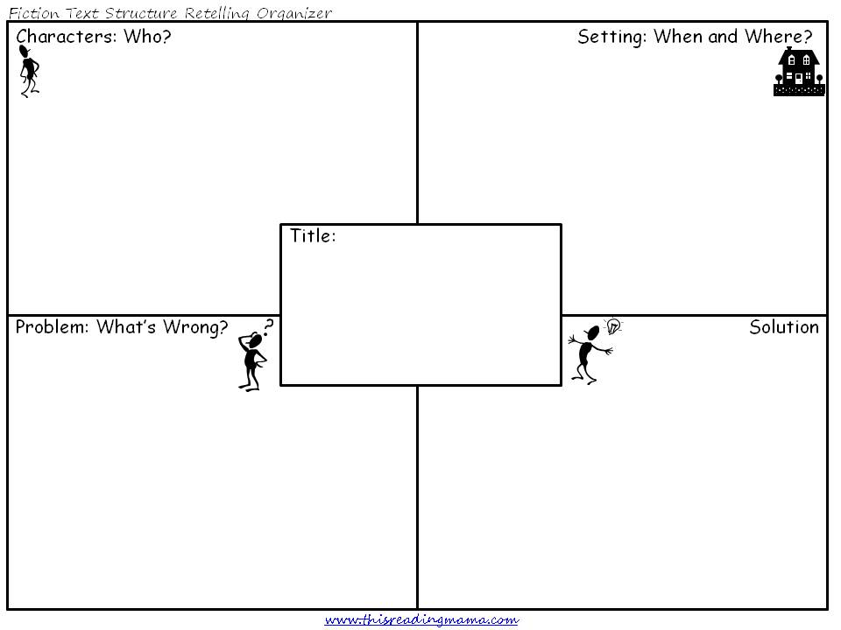
Story plan templates from: www.thisreadingmama.com

Slide 8
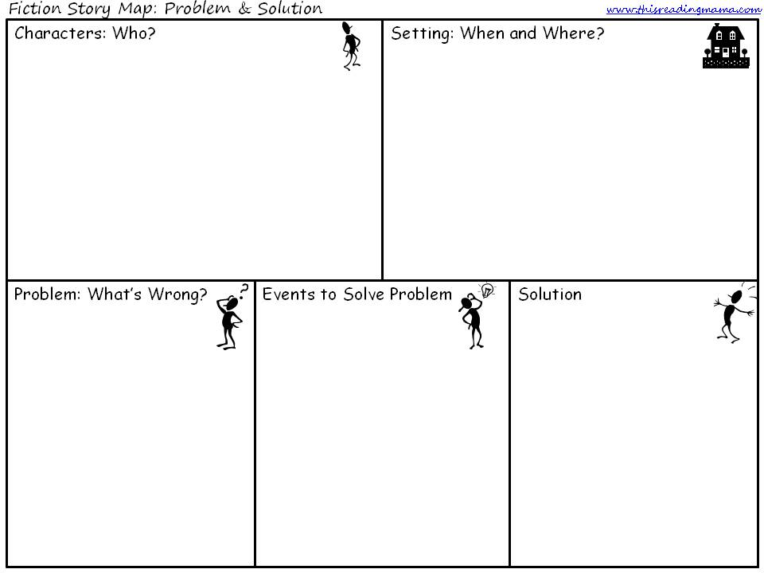
Story plan templates from: www.thisreadingmama.com

Slide 9
Key elements for writing a good script
Have a single motive or theme.
Have one main obstacle or problem that the hero has to solve (external force) but also have a personal obstacle (internal journey) for the hero to travel through.
You can get the audience to believe anything so long as you do it in stages.
The audience needs to be able to ‘root for’ the main character.
Set up the theme of the story early.
In the unfolding of the storyline, follow a structure.
Stick to a plan and follow it. Don’t jump around too much in the time lines.
Don’t confuse the audience by changing themes, main characters or giving the hero a characteristic that goes against what you have set up.

Slide 10
Key elements for writing a good script continued
9. Don’t add anything that doesn’t make sense to the premise of the story or the characters. However have an element of surprise.
10. There should be urgency on the part of the hero to achieve his goal.
11. Use the story to teach the audience something, a view point, a theory on life etc.
12. Be specific in the type of world you create.
13. Create details in the world you have for the audience. Fill it with details that will show how it impacts on the characters and the way they live.
14. Make sure the ending satisfies the audience in some way; don’t leave ALL the questions unanswered or ALL the conflicts unresolved.
15. Choose the Genre you wish to make.
16. Use the story to express a view point that is more than just the storyline.
Based on articles:
“10 common elements of great screenplays” by Elliot Grove
“Elements of a good script” by Carson Reeves

Slide 11
Coming up with a good visual image
Drama
Key components are the same for any genre or format, whether it is a short film, tv series, podcast, or feature film. Keep to the 3 Act structure and keep the idea new and exciting or tell it in a different way.
Documentary
Look at current issues, or target audience relevant topics. Come up with a different way of looking at the subject (new viewpoint).
Start by researching the subject and other stories already produced then chose a different angle, may be something more controversial or emotional.
Always think about the opposing view point, use this to develop your topic, include this in the documentary but not as much as the point of view you are trying to sell.

Slide 12
Coming up with a good visual image
Music video
Look at the lyrics, what story does it tell? Is there a dramatic aspect already there. Are there key words that evoke visual images: can they be strung together to matching with the song?
Look at the band – what do they stand for, represent, look like? Can this be used to provide visual images for the song?
Close your eyes and listen to the song … what do you think of? See? Even if they are random images can they work as visuals for the song?
Use the performance of the band as cut-aways or as the main vision with random images as cut-aways.
Or simply decide on images and cut these images to the beat of the music.

Slide 13
Where do you get good ideas?
Day dreaming- ask yourself the question:
“what if…?”
“ If only…”
“I wonder…” and “If this goes on…”
“wouldn’t it be interesting if …”
Brain storming, mind mapping
Newspaper articles, stories, adds and personal column
Books/ short stories/ poems/ Bible/ Fairy-tales and Myths
Other movies/ combination of more than one
Television shows/ current affairs programs/ comedy sketch shows
Internet- Google search a word, statement, idea, subject / face book/ news articles
Maybe a name from the telephone book/ yellow pages

Slide 14
More ideas …
Music, song lyrics
Other people; listen to conversations of strangers, asks friends & family for ideas
Science and technology magazines (new ideas and inventions)
Look at photos/ copy text in cards
Psychology books for ideas and insights into human behaviour
Television commercials
Life events
Use your own hobbies and interests as a subject
Go to the art gallery and use art as inspiration/ or go to the museum use history as inspiration
Connect two unrelated things
Write from a prompt – book “The Pocket Muse: Ideas and Inspirations for writing” by Monica Wood

Slide 15
Let’s try some idea generation techniques!
Graffiti (group work story generation)
Two random objects- (lucky dip)
Google search- (in class: brainstorm words. Take ‘call-outs’ and write on the board then select one/ several and Google search for meanings & stories)
Look at Art work- (mood, feeling, style)
Newspaper/ magazines – (look at articles, find something interesting)

Slide 16
Story generation via the Graffiti Game:
Form class into small groups; 5 groups total.
Hand out to each group a separate piece of paper with a key word written on it:
Location
Hero character
Main villain
Problem to solve
Obstacles to overcome
Give each group 5 minutes to come up with as many words/ ideas under the heading as they can. (No restrictions- let their ideas run wild)
Pass on the paper to the next group and get them to do the same without worrying if it has already been written down. Go through all groups with each paper.
Collect up the papers. You should end up with about 20-30 words on each page.
Then ask each group to choose a number from 1-20.
Whatever number they choose, go through the sheets of paper and count down the words until you reach that number and that then becomes their location, main character etc. (If you don’t have enough words recount the same words). You can ask them to choose 5 different numbers and then make the first number their choice for locations, next number Hero character etc., whatever you think will work for your group
Then using this information get them to develop a storyline based on the random aspects they have been given.
The students can use this for inspiration, they can also choose what genre to make the story, also what time period etc. This should just give them a great starting point. (You don’t have to make them stick to these choices it is just to get them creating story ideas).

Slide 17
Extra Reading: Writing Short Film Scripts A Student Guide to Film Making by Paul Kooperman

