Slide 1
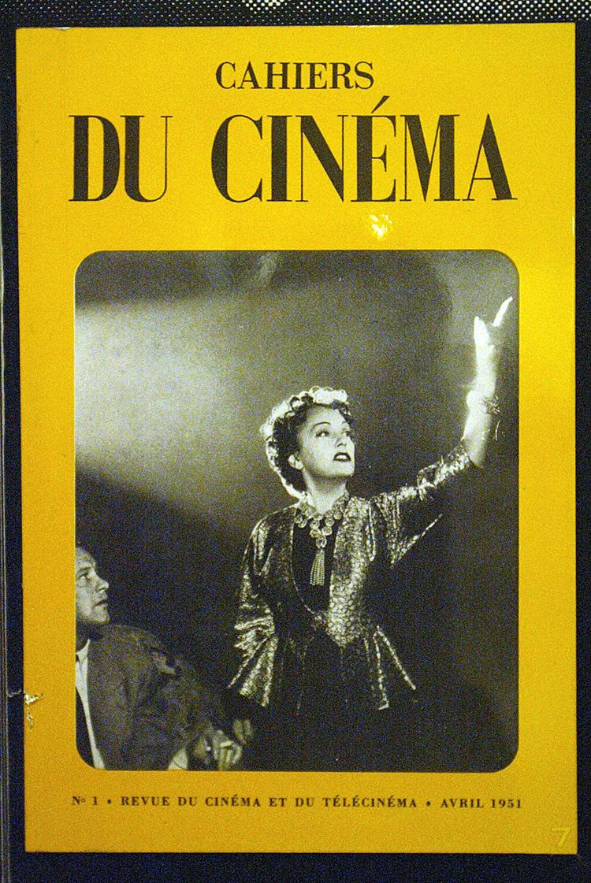
Auteur Theory
Originated in the 1950s, published in a magazine called Cahiers du Cinema
Irritated with French Cinema, seen as old-fashioned, ‘dad’s cinema’ - cinema du papa
Francois Truffaut provocatively said: ‘(t)here are no good and bad movies, only good and bad directors’
Critics writing for Cahiers reviewed America films and noticed certain traits within a directors work

Slide 2
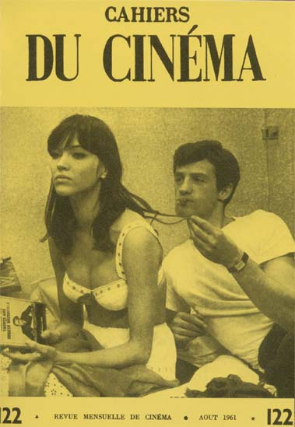
Auteur Theory
They encouraged directors to work within the studio system to imprint their name on creative work
Alexandre Astruci: ‘Use the camera like a pen’…
Film as art, not just a piece of entertainment
Product of an individual’s imagination

Slide 3
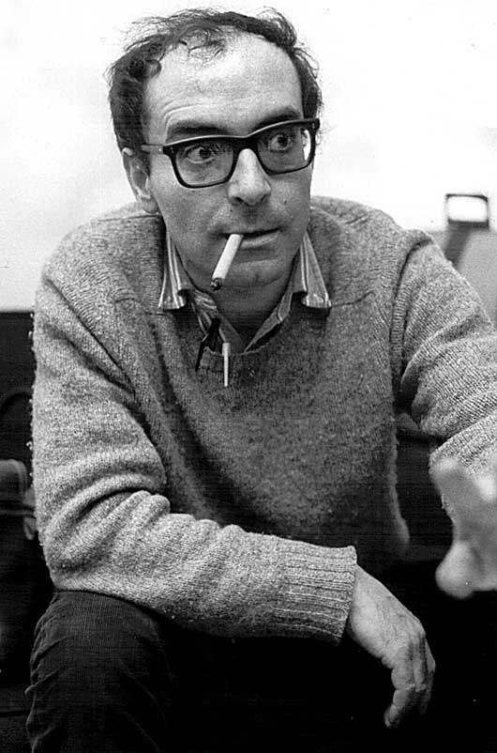
Auteur Theory
Made a habit of attacking the most artistically respected French film makers
Jean Luc Goddard: ‘ Your camera movements are ugly because your subjects are bad, your casts act badly because your dialogue is worthless; in a word, you don’t know how to create cinema because you no longer know what it is.’
The Cahiers contributors did not just write, they also directed films…
Jean-Luc Goddard

Slide 4
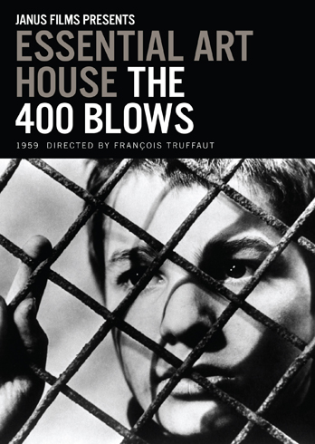
Auteur Theory
Rivette made Paris Belongs to Us (1961)
Goddard made Breathless (1960)
Truffaut made The 400 Blows (1959)
These films were known as French New Wave cinema
The 400 Blows won the Grand Prize at the Cannes Film festival
Goddard: “We won the day in having it acknowledged in principle that a film by Hitchcock, for example, is as important as a book by Aragon. Film auteurs, thanks to us have finally entered the history books.”

Slide 5
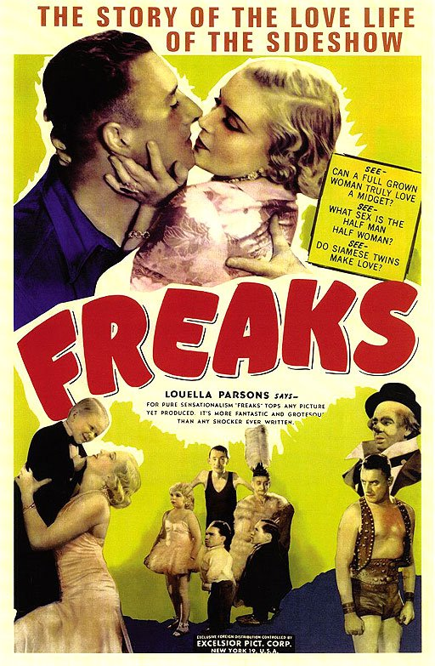
Auteur Theory
The director as Auteur had certainly been around before the 1960s, but these directors were few and far between, such as Tod Browning, (Freaks 1932) who was dubbed ‘the Edgar Allan Poe of the cinema’
He made films such as ‘Dracula’ in 1931 and was the king of the early horror genre
But these directors were not known as auteurs until the development of auteur theory in the late ‘50’s & ‘60’s
It was not until the end of the Studio System (started by The Paramount Decree 1949) in the late fifties and early sixties, that the director, had any chance of becoming an auteur because of the strict control that the studios held over the individual

Slide 6
Director of Auteur
Dictionary definition: ‘…dominates the film-making process’ so much ‘…that it is appropriate to call the director the auteur, or author, of the motion picture
The theory also states that the director projects his or her own personal style onto the film as they are ‘…the primary person responsible for the creation of’ the film
However, another important aspect of this theory is the ‘…commonality of theme’ that is seen in each of the films that the director makes

Slide 7
Traditional French Cinema
Large budgets
Established stars
Literary/historical characters (archetypal heroes)
Adaptations of classics (popular but little thematic originality)
Traditional narratives (classical construction and plot)
Domination of scripted dialogue (power of scriptwriter)
Big production machinery (crew and equipment)
Studio sets (artificial light and post synchronised sound)
Heavy technical equipment (not very versatile)
Commercial success and popular audiences (profitable, around 5-7M spectators)
Example: Les Enfants Terribles (1950)

Slide 8
French New Wave
David Bordwell: ‘…to the proponents of the carefully polished French “cinema of quality,” the young directors must have seemed hopelessly sloppy.’
Casual look
Actors improvised lines
Relatively small budgets
Co-productions and self-production
New generation of young actors/ actresses playing young characters
Original screenplays and/ or adaptations (auteur)
Personal tone and themes (auteur)
Modern tone
Technical innovations at the service of the New Wave
Natural sets/ location shooting
Natural light - Studio lighting replaced with day light
Example: Breathless (1960)

Slide 9
Andrew Sarris
American film theorist, 1960s
Used the French auteur theory to elevate American cinema
Bar one or two European films, all good cinema came out of Hollywood
This led to the notion of ‘good’ or great ‘directors’ and the rest
Not the intent use…

Slide 10
Andrew Sarris
Recognising the film’s ‘author’ does not necessarily make it a good film
‘The Three premise of the auteur theory may be visualised as three concentric circles, the outer circle as technique, the middle circle a personal style, and the inner circle interior meaning. The corresponding roles of the director may be designated as those of a technician, a stylist, and an auteur.’

Slide 11
Concentric Circles
Technician: Techniques
Stylist: Personal style
Auteur: Interior meaning

Slide 12
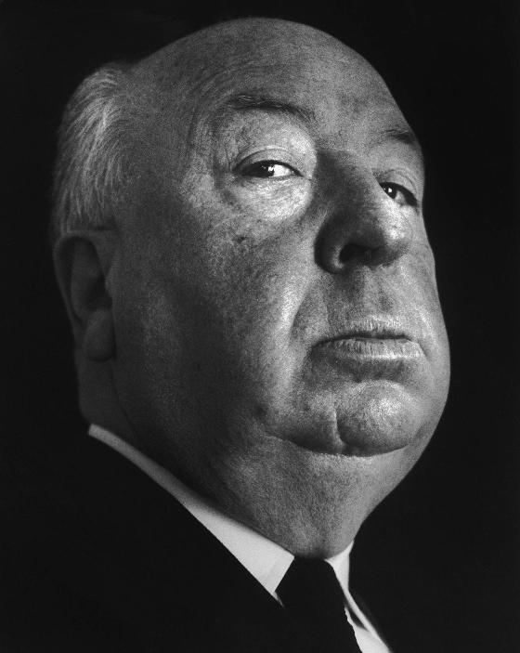
Hitchcock’s Circles
Technician: strict filming schedule and unusual camera angles. Total command over all elements.
Stylist: suspense, thriller genre, lovable rogue characters, gritty.
Auteur: Loneliness (Hitchcock was lonely as a child), The wrong man falsely accused (Hitchcock was accused wrongly by his father as a child.

Slide 13
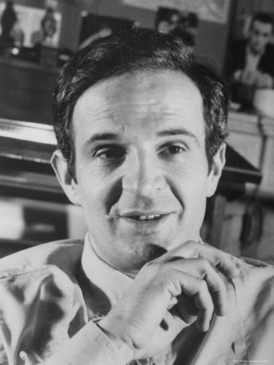
Truffaut on Hitchcock
The virtuoso editing
The lyrical camera movements
The droll humour
The wrong man falsely accused
Violence erupting at the times it was least expected
The cool blonde (often emotionally tortured)
Creation of cinematic tension

Slide 14
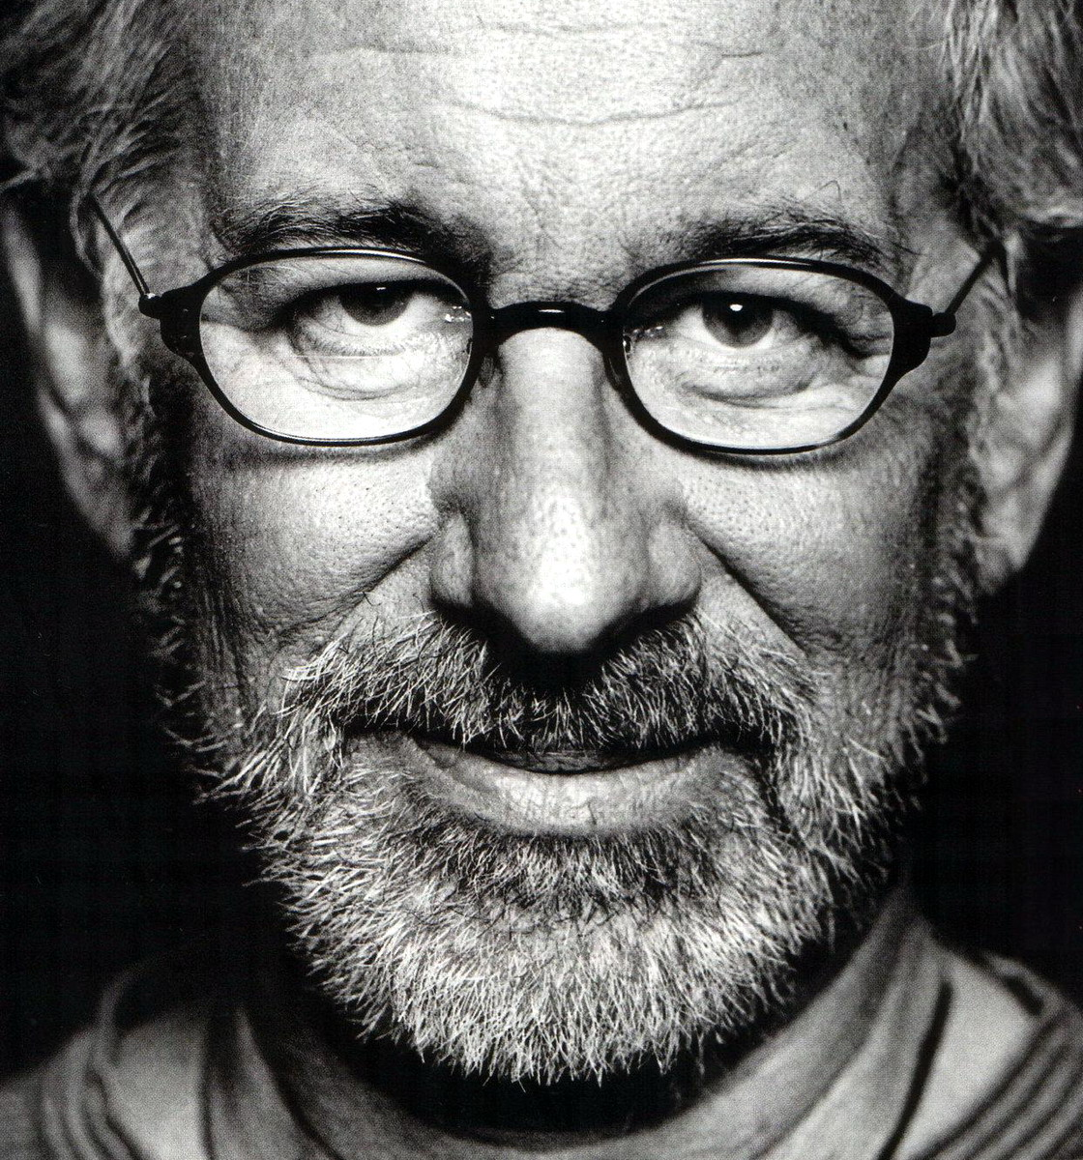
How To Recognise and Auteur
To be considered an auteur, a film-maker must have a body of work (oeuvre) which can be analysed for on-going themes and considerations, whether they occur intentionally or unintentionally
One example would be the theme of the distant father in Steven Spielberg's work
In addition to this, an auteur must have a differentiating style, almost instantly recognisable

Slide 15
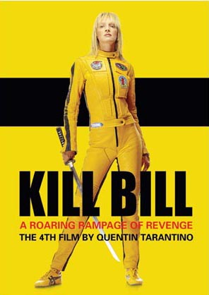
Selling Films through Auteurs
Directors (auteurs) can be used to sell films
. Tim Burton, Spike Lee, David Lynch, Woody Allen, Martin Scorsese, Francis Ford Coppola, Ridley Scott or Steven Soderbergh "brands."
. Often their names are on the top of the poster to market to fans

Slide 16
Metteurs en Scene
François Truffaut argued that good directors are not necessarily auteurs
No authority and not personal ‘stamp’
A good example is Peter Jackson, the director responsible primarily for the Lord of the Rings trilogy
Despite the fact he has previously written his own films, in adapting someone else’s work he removes a certain amount of artistic control
Bound by economic pressures in which Hollywood places economic success over artistry
Jackson lacks over ridding themes, recognisable artistic design
No personal views included in his films
Good director but lacks the credentials to be called an auteur

Slide 17
Issues with Auteur Theory
Films are a collaborative effort
Ignores the role of writers, actors, musicians
Praise for the director at the expense of everyone else
The most powerful force in most films is the studio under which it is being made
New Crticism, argued that making meaning out of what directors were attempting to portray was secondary to the actual visualisation on screen

Slide 18
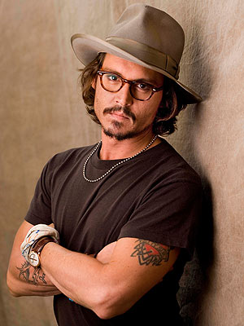
Acting Auteurs
Case being made for the actor as auteur
Where an actor/actress seems to play a similar kind of character from one film to another or has a distinctive style of acting
Actress Kerry Fox recently suggested that US actors always want to be recognised in films whereas the UK way is to become your character
Not always sure if a character is a product of direction or actor

